Slide 1
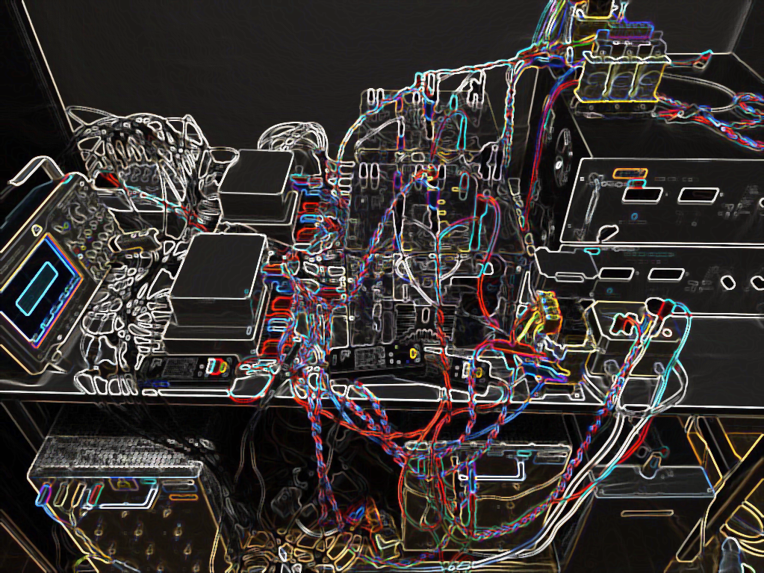
Neural network-based imitation of model predictive control for power converters
Aitor Teran, Cristina Roche, Pere Izquierdo

Slide 2
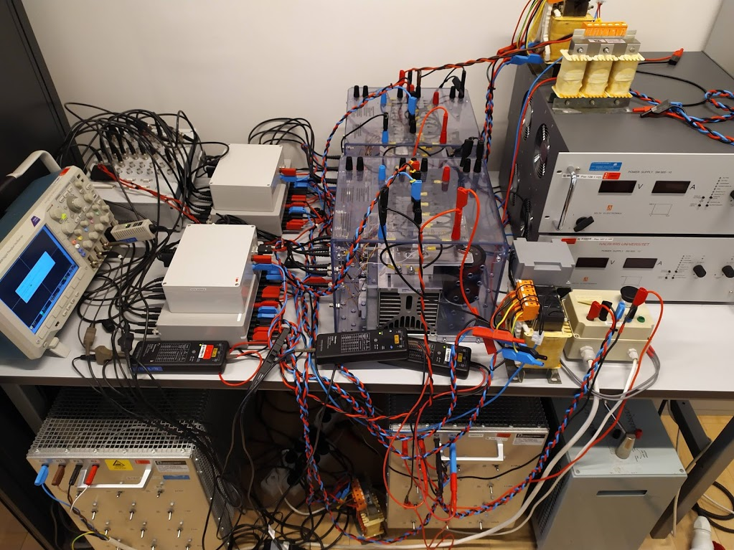
CONTENT
INTRODUCTION
PROBLEM ANALYSIS
FS-MPC
NEURAL NETWORKS
ANN IMITATOR METHOD
RESULTS
CONCLUSION
FUTURE WORK

Slide 3
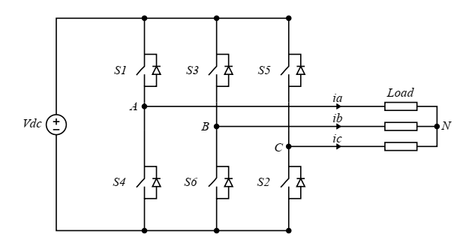
INTRODUCTION
Potential of Artificial Neural Networks (ANN):
Short execution time
Pattern recognition
Modelling of nonlinear systems
Control of power converters?
Notes:
Artificial neural networks have been a fundamental part of many research breakthroughs in recent years due to their ability to execute complex structures in short processing times, to find patterns from data for modelling relationships for which no mathematical description exists or is not accurate, i.e. to approximate any continuous function. This high potential is aimed to be applied to power converters

Slide 4
PROBLEM ANALYSIS
Control of power converters?
Artificial neural networks
Finite set model predictive control
Imitator controller
Scope
Resistive load
Simple inverter topology
Notes:
The main goal is to obtain an artificial neural network that is able to imitate the finite set model predictive control algorithm for inverter control purposes, achieving similar performance while reducing its computational requirements.
The inverter to be controlled is a three-phase six switch inverter connected to a resistive load, therefore the objective of this project is to prove whether neural networks have potencial to be applied to power converters field, characterized by a short control signals period. The sampling time is fixed to 20 micro seconds because mpc to be executed needs that period and this is needed for experimental comparison purposes
Validate the potencial

Slide 5
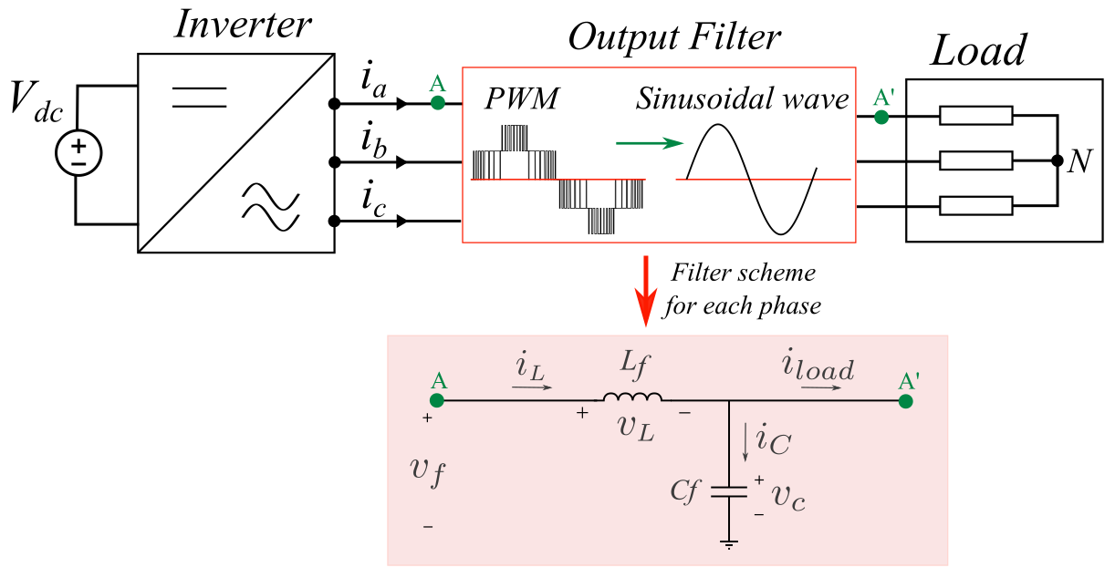
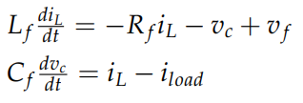
MODEL
Notes:
The model of the plant basically consists in the filter. The second order low pass filter is formed by an inductor in series and a capacitor in parallel, i.e a LC circuit. The inverter dynamics are considered to be ideal. This filter is used to attenuate the amplitude of the harmonics to get a smooth sinusoidal fundamental wave.
(dead time is not modelled because inverter is considered to be ideal)

Slide 6
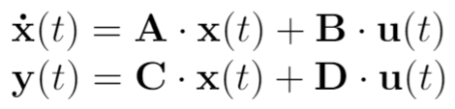
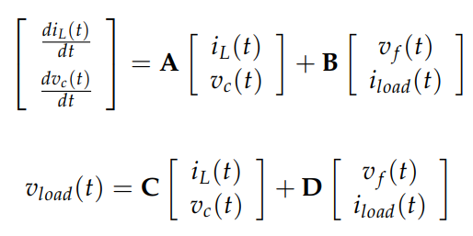
MODEL
State space
Notes:
LTI system, state space model representation, being u the control signals, ir.e the switching vectors and the current through the load. The states are the voltage through the load or capacitor and the ouput current of the inverter.
The goal of the state space model is to be used as a simulation for finding the rate of change of the state variables. Given the input signal and the previous states values, the model can be used to predict the system behaviour in the next sampling instant.

Slide 7
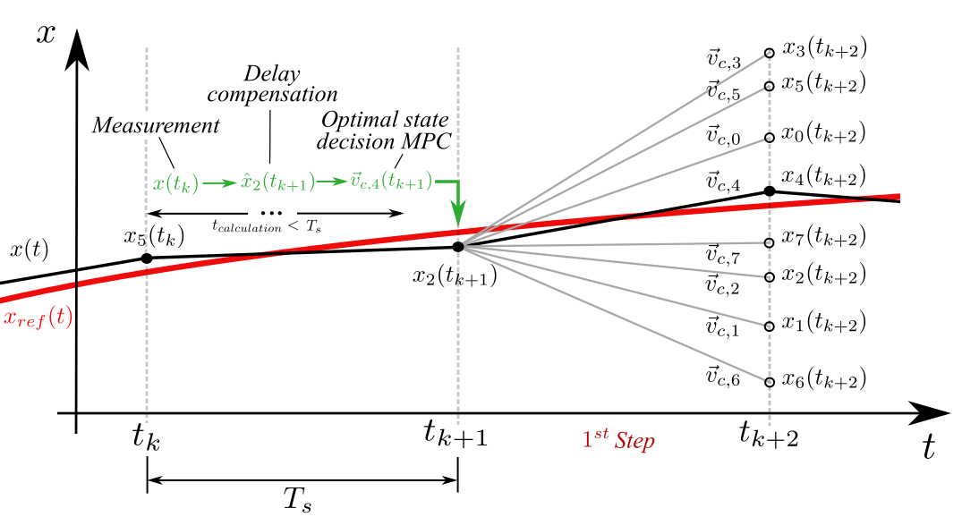
FS-MPC
Algorithm that uses the model of the system to predict the control action that minimizes error.
Optimal decision
Notes:
-FS-MPC stands for finite-set model predictive control.
-Model predictive because it makes use of a model of the system to compare predictions to references, finite-set because there’s a limited number of control outputs, which are the 8 possible switching combinations. Through the states prediction it compares them with the reference and choose the proper control decision that tracks the reference the best.
-Explain the figure: In summary, predictions are obtained for each possible control action through the use of the state space model of the system. Then, the performance of each control action is compared by calculating the cost function for each of them. The chosen control action will be applied in the next sampling instance. (it gives the switching command, so no modulation technique is needed).
-MPC can use different number of steps predictions to take the decision. In the figure only for one step ahead prediction is shown, therefore the model has to be run 8 times. In case the decision can be made taking into account 2 steps ahead behaviour, for each of these again 8 possible switching states should be considered, therefore 8^2 combinations, which results in running the model 64 times, which requires high execution time. And the number of calculations to be performed online increases exponentially.

Slide 8
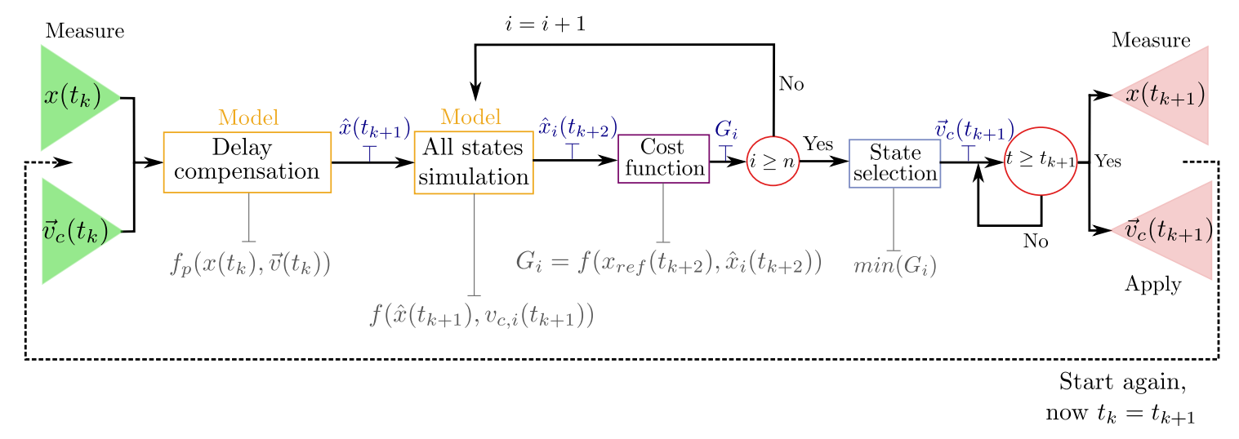
FS-MPC
Notes:
Working principles
For one step ahead prediction the diagram shows the steps followed by MPC, both zero vectors for simplification are taking as only one control action, so we only have 7 possible control outputs.
-First, at the beginning of every sampling period ,i,.e. k, we get the new measurements x(tk) in abc reference frame. This is transformed to alfa-beta reference frame through vector projection.
-Through the state space model the values of the states in the next sampling time can be estimated (x^(tk+1)). This estimation is the output estimation that the setup is gonna give in the next sampling time with the already decided control action. This is called delay compensation.
-the model is run again but now in a loop for each of the 7 possible switching states and the estimated values. These gives 7 possible outputs for tk+2.
-the cost function of each is computed.
-with the 7 cost functions, the minimum one gives the switching state chosen to be applied at tk+1
Todos los caltulos tienen que entrar entre tk y tk+1, por eso contra mas steps ahead mas reducido esto.
X(tk):
Three pahses of:
(States)
Filter currents iL (measured)
Capactitor voltages vc (measured)
(inputs)
Load currents (measured)
Applied voltage to the filter (the previously output of the state space model by the optimal decision)

Slide 9
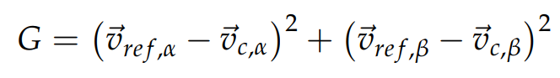
FS-MPC – Cost function
Flexible decision
Any state or variable can be included
Decision based on linear or non-linear behaviour
Basic cost function: reference tracking
Notes:
The goal of the cost function is to proper compute a value that represent how good that control decision (switching state) is.
FS MPC takes decision based on a cost function, or function that penalise not desired behaviours.
This makes MPC flexible and broadens the control possibilities, because any state or variable of the system can be included in the decision logic and can decide based on linear or non linear behaviour also.
Basic one: Euclidean distance between the desired and the obtained voltages.

Slide 10
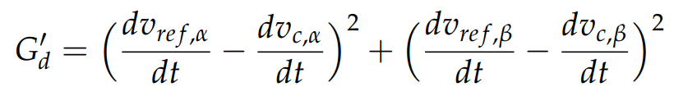
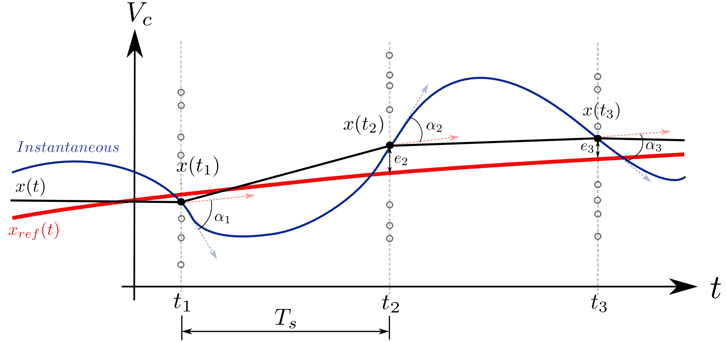
FS-MPC – Cost function
Secondary objectives: derivative dynamics
Notes:
Secondary objetives can be several, but based on literature, we chose a derivatives of the load voltage term
Again the Euclidean distance between the dereivative of the voltage reference and the derivative of the load voltage is penalized.
This results in very improved performance of the mpc for one step horizon. Because the switching state chosen could be the best one for the sampling instant but have large derivative at that point, and therefore lead to a worse value in the next sampling instant.
Otros posibles objetivos: switching losses

Slide 11
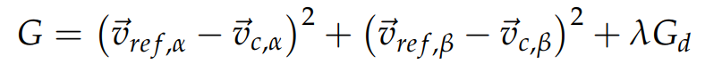
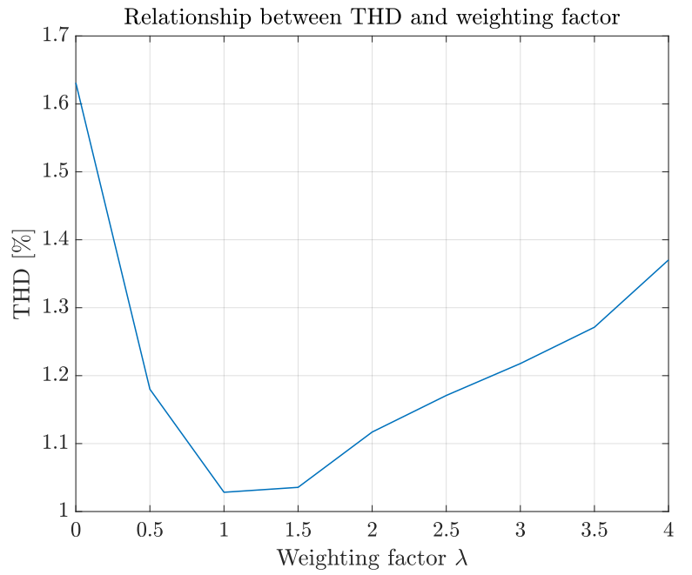
FS-MPC – Cost function
Weighting factor
Notes:
Terms in the cost function are added through a weighting factor.
Trade-off decision
Its tested and in terms of thd phase voltage the best value is 1.

Slide 12
FS-MPC- Advantages and drawbacks
Flexible control actions decision through the cost function
-Accurate transients
-Multiple and non-linear based decisions
Sampling time: trade-off decision FS-MPC execution time < Sampling time
A short sampling time
- improves the performance
- limits the number of steps ahead horizon
- limits the complexity of the possible converter
SOLUTION: to run MPC offline and train an ANN with the data
Notes:
Advantages: Flexible control actions through the cost function, which allows to hace accurate transients and to make control actions decisions based on multiple objectives and non linear dynamics.
Disadvantages: the sampling time decision is a trade-off decision, it has to be longer than the mpc execution time. Therefore, a short sampling time is needed to improve the performance because the frequency of the control actions is increased and therefore the precision of the output. However, it limits the number of steps ahead horizon and the possible complexity of the converter topology.
The solution to this disadvantage is to run mpc offline, to not to have the sampling time requirement and train a ANN with this data, and then control with the ANN because its execution time is lower.

Slide 13
CONTENT
INTRODUCTION
PROBLEM ANALYSIS
FS-MPC
NEURAL NETWORKS
ANN IMITATOR METHOD
RESULTS
CONCLUSION
FUTURE WORK

Slide 14
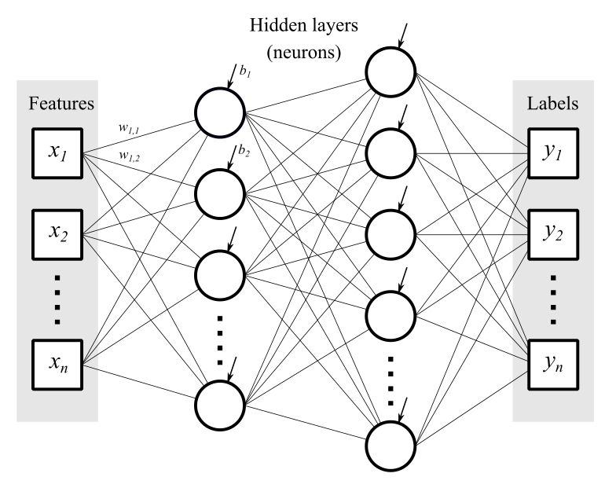
PROPOSED SOLUTION
Inputs
Outputs
Low computational burden.
Ability to imitate different controllers.
Notes:
The proposed solution is to use a neural-network-based imitator.
A neural network is computationally cheap universal approximator.
Neural network basics: each neuron computes previous values times weight vector and adds a bias value, then going through a nonlinear activation function.
Dejar feaures y labels en vez de inputs y outputs

Slide 15
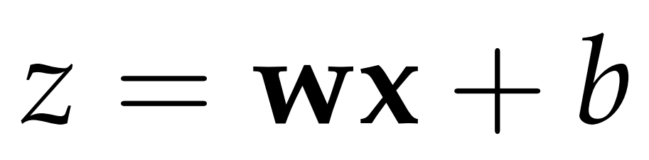
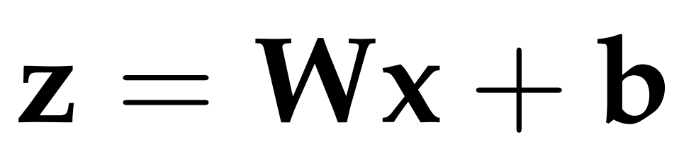
ARTIFICIAL NEURAL NETWORKS
Linear behaviour of a single unit:
Linear behaviour of a whole layer:
Notes:
The proposed solution is to use a neural-network-based imitator.
A neural network is computationally cheap universal approximator.
Neural network basics: each neuron computes previous values times weight vector and adds a bias value, then going through a nonlinear activation function.

Slide 16
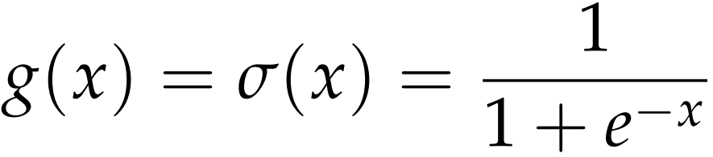
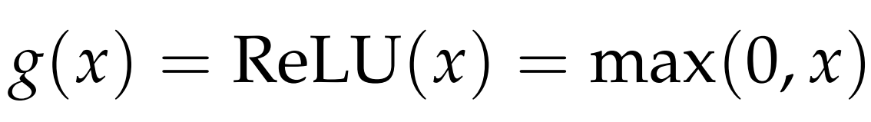
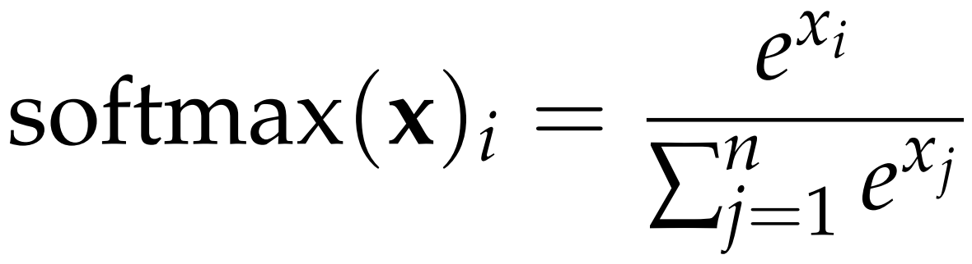
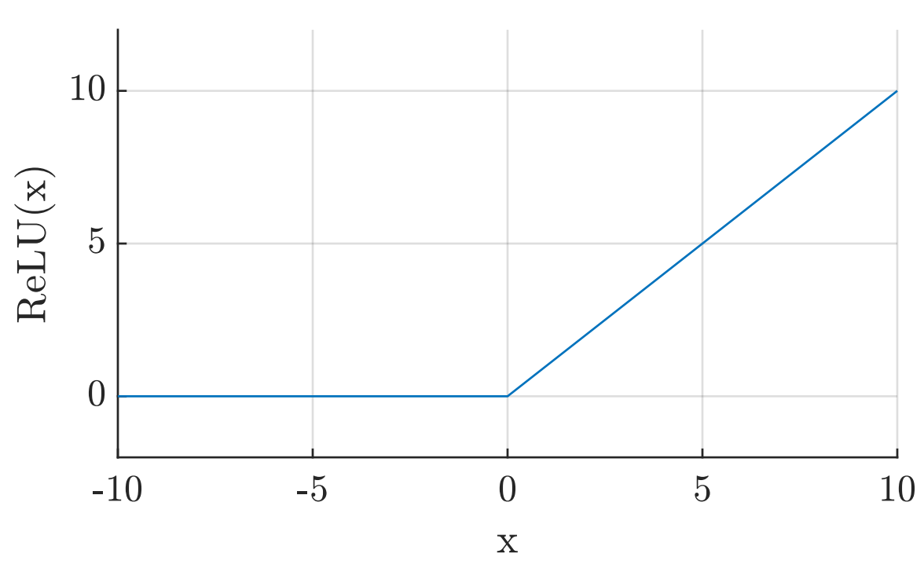
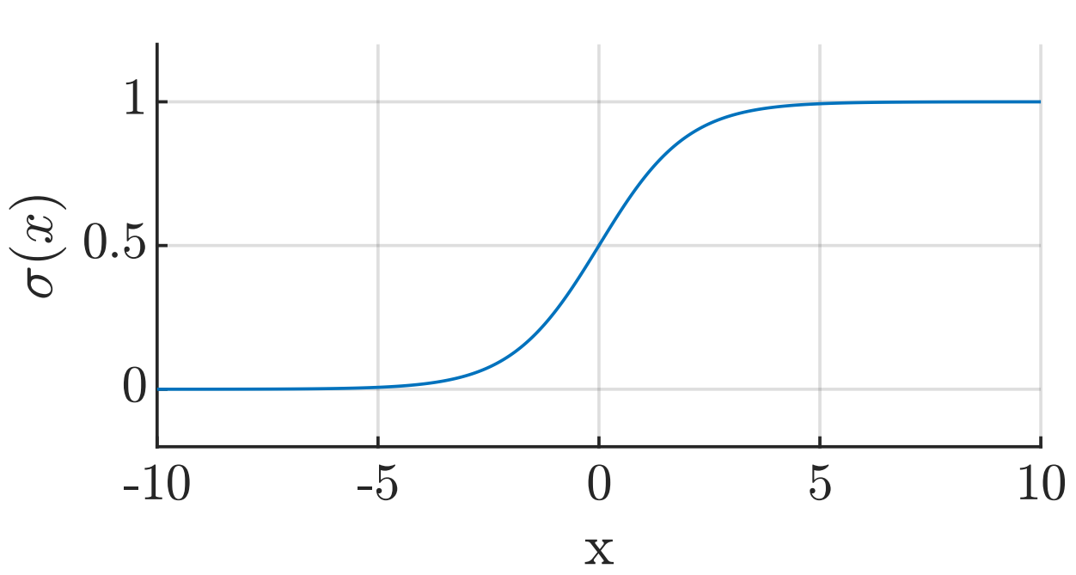
ARTIFICIAL NEURAL NETWORKS
Activation functions:
Notes:
The proposed solution is to use a neural-network-based imitator.
A neural network is computationally cheap universal approximator.
Neural network basics: each neuron computes previous values times weight vector and adds a bias value, then going through a nonlinear activation function.

Slide 17
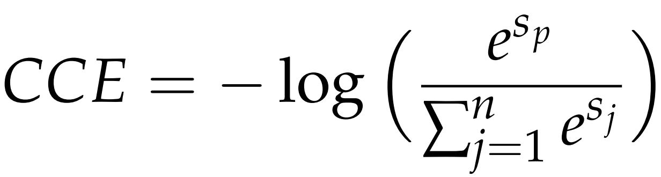
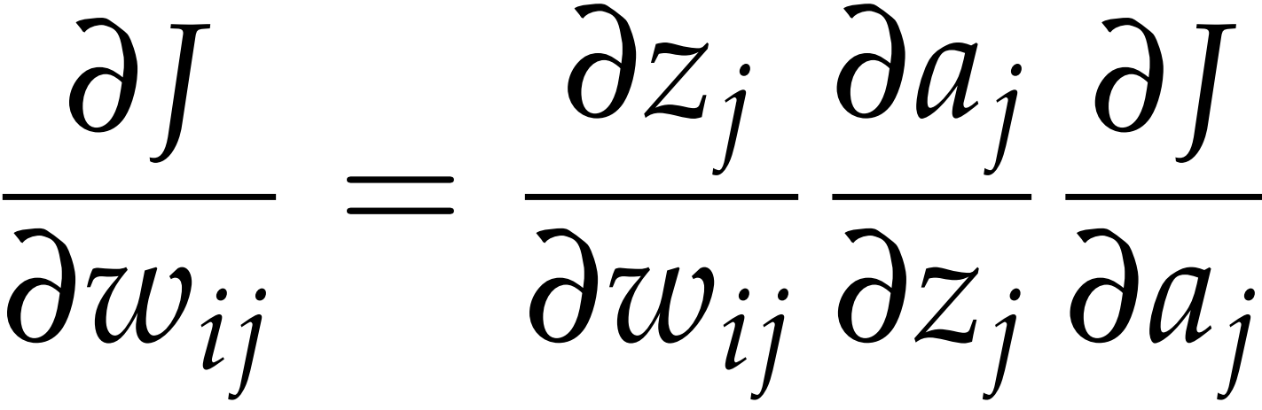
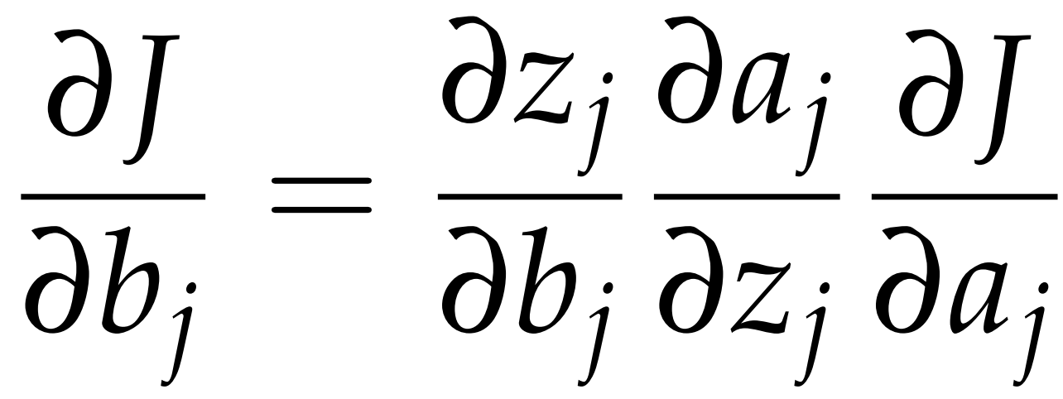
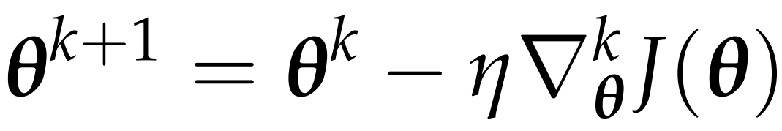
ARTIFICIAL NEURAL NETWORKS
Cost function:
Gradient computation through the back-propagation algorithm:
Network parameter update using steepest descent:
Notes:
The proposed solution is to use a neural-network-based imitator.
A neural network is computationally cheap universal approximator.
Neural network basics: each neuron computes previous values times weight vector and adds a bias value, then going through a nonlinear activation function.
Sustituir theta por w y b

Slide 18
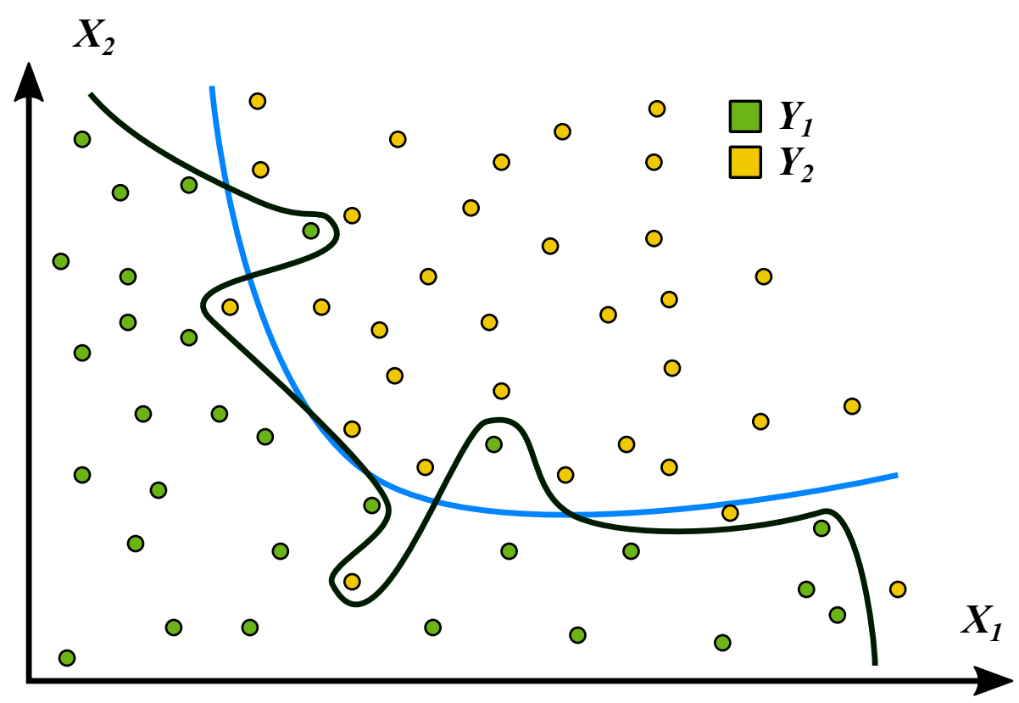
ARTIFICIAL NEURAL NETWORKS
Training a neural network.
Notes:
The proposed solution is to use a neural-network-based imitator.
A neural network is computationally cheap universal approximator.
Neural network basics: each neuron computes previous values times weight vector and adds a bias value, then going through a nonlinear activation function.

Slide 19
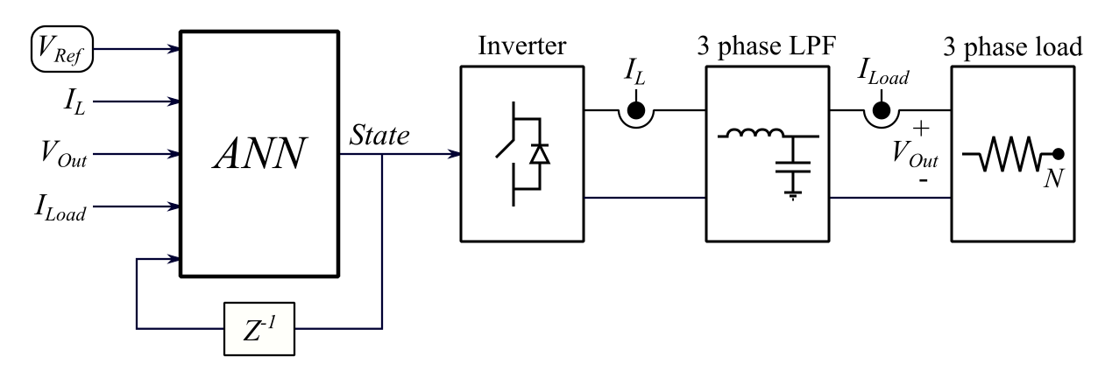
DATA ACQUISITION
2 million training data points
1 million random validation and test data points
Notes:
Explain the control scheme. Inputs: reference voltage, output voltage, inductor current, load current, previous system state.
Network trained using TensorFlow in Python using 2 million grid-generated data points within the operating range of the lab setup.
Validation and testing of the neural network performed on 1 million random data points inside the same bounds.

Slide 20
CONTENT
INTRODUCTION
PROBLEM ANALYSIS
FS-MPC
NEURAL NETWORKS
ANN IMITATOR METHOD
RESULTS
CONCLUSION
FUTURE WORK

Slide 21
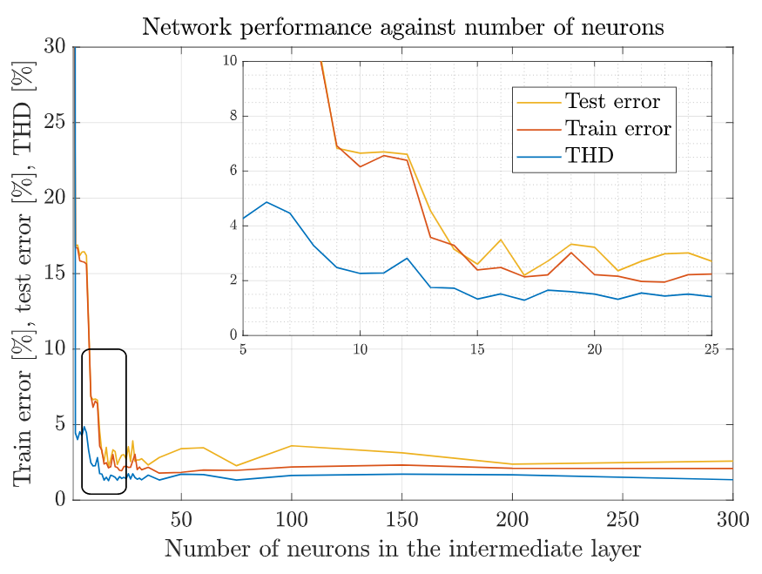
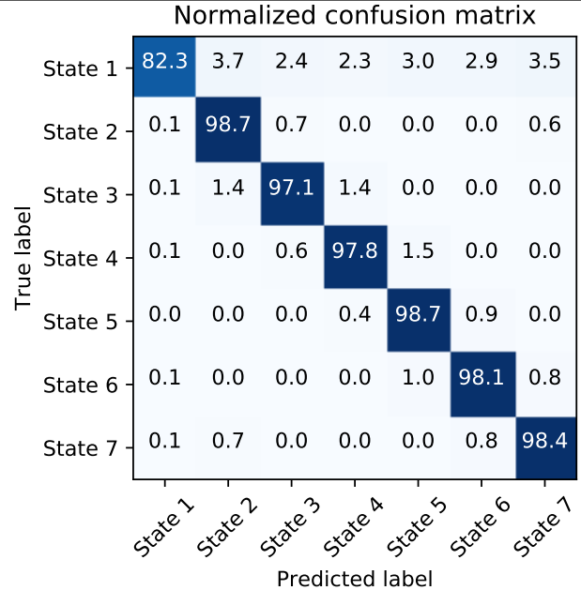
TRAINING THE NETWORK
Finding the optimal network configuration.
1 hidden layer with 15 neurons.
98% test accuracy
Notes:
Finding network configuration: activation functions, cost function, optimization algorithm. Non-convexity of training a neural network.
Adding several layers does not significantly improve the performance of the network.
For a single layer, error and THD values are compared to obtain the optimal number of neurons.
EXPLICAR QUE ES 98% TEST ACCURACY

Slide 22
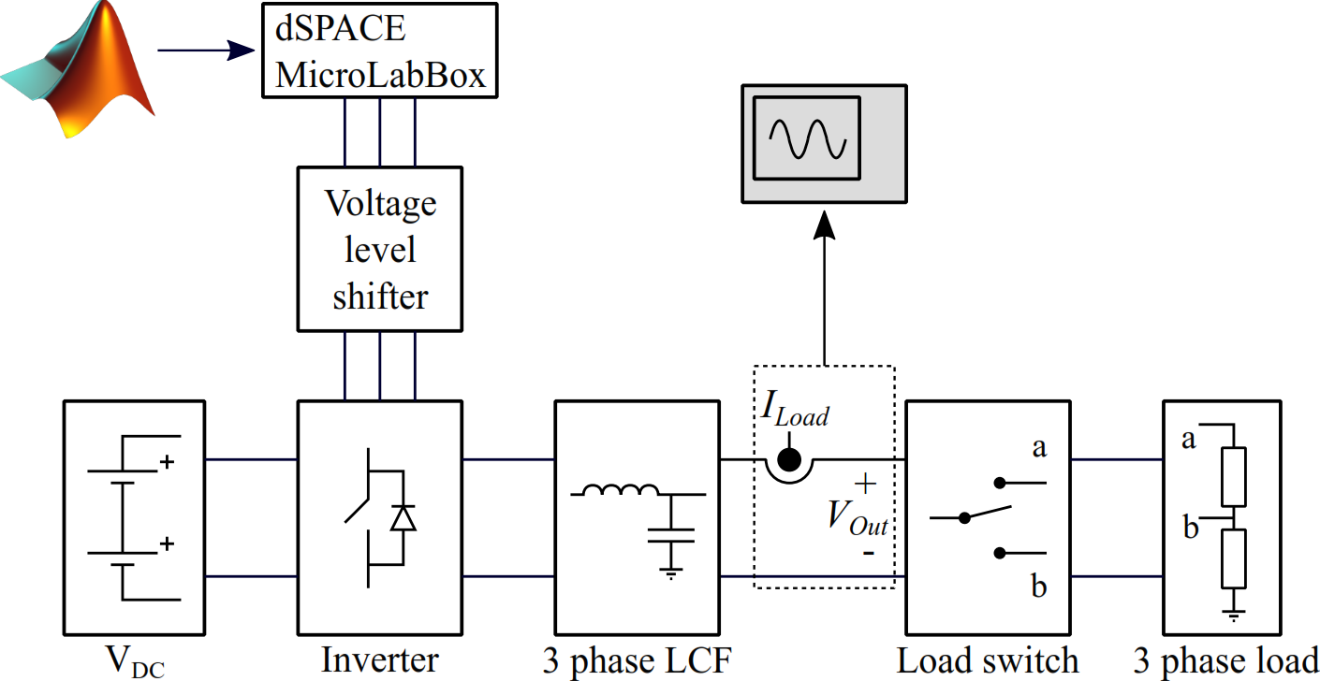
LABORATORY SETUP
Notes:
Explain the control scheme. Inputs: reference voltage, output voltage, inductor current, load current, previous system state.
Network trained using TensorFlow in Python using 2 million grid-generated data points within the operating range of the lab setup.
Validation and testing of the neural network performed on 1 million random data points inside the same bounds.

Slide 23
EXPERIMENTAL PROCCEDURE
Steady state performance
Transient response
Robustness test
Reference frequency change
Reference voltage change
Notes:
This slide shows how good the ANNs are at approximating MPC.
Very similar THD and switching frequencies.
1-step MPC takes 10 us, 2-step takes 13 us. ANNs always take 11 us.

Slide 24
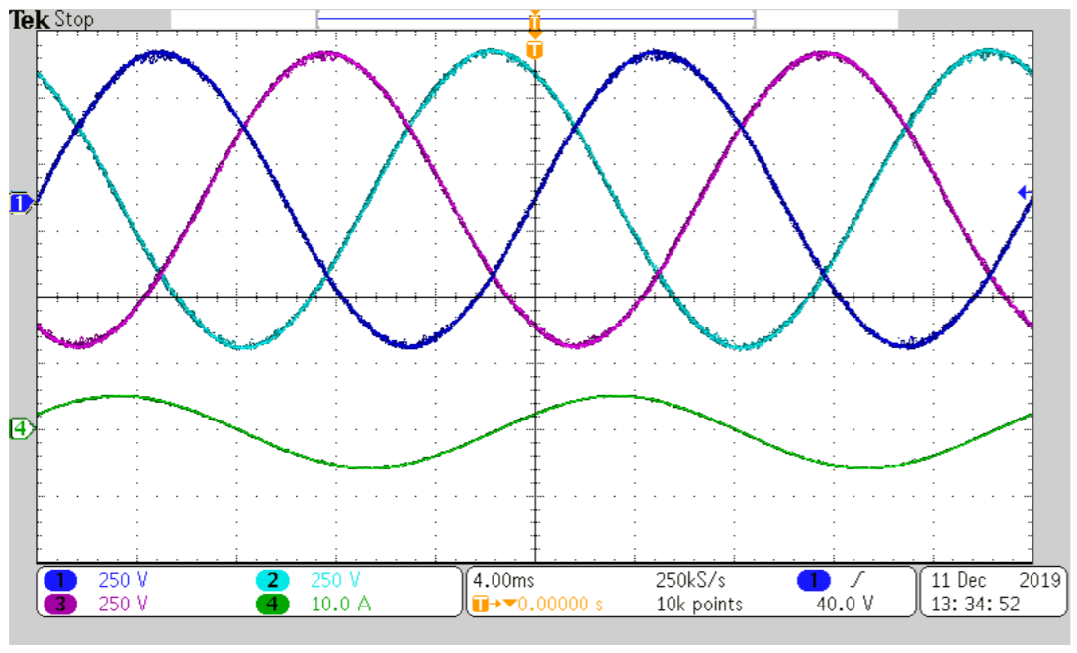
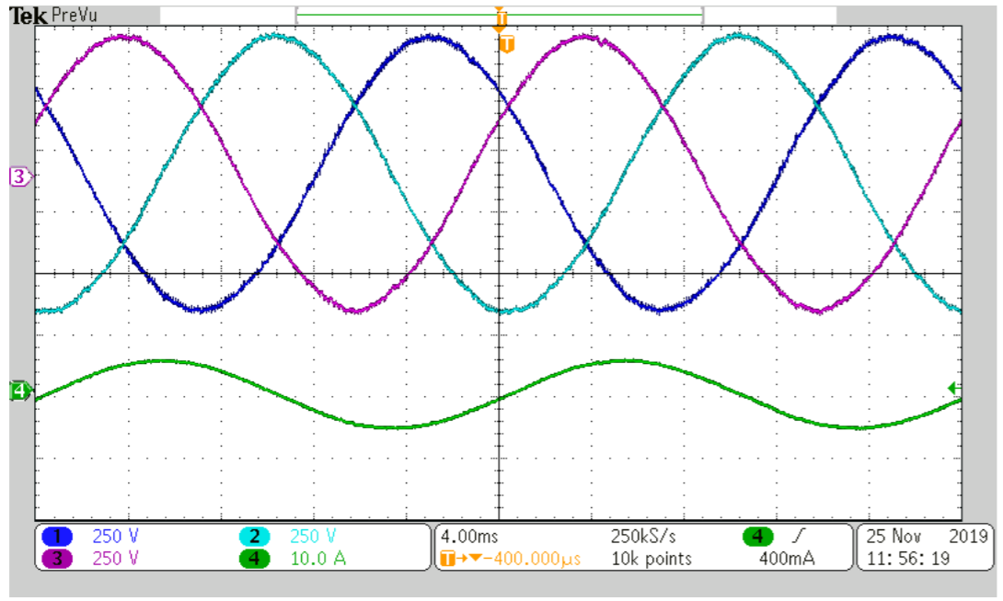
RESULTS
MPC
Why is the same figure shown twice?
ANN
Notes:
This slide shows how good the ANNs are at approximating MPC.
Very similar THD and switching frequencies.
1-step MPC takes 10 us, 2-step takes 13 us. ANNs always take 11 us.

Slide 25
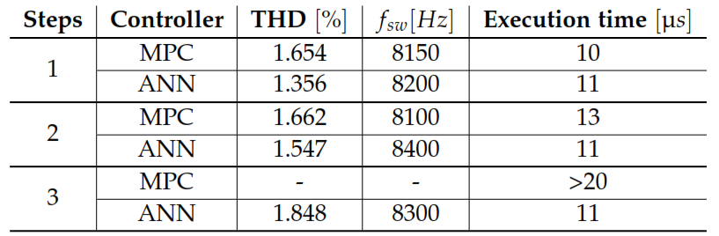
STEADY STATE

Slide 26
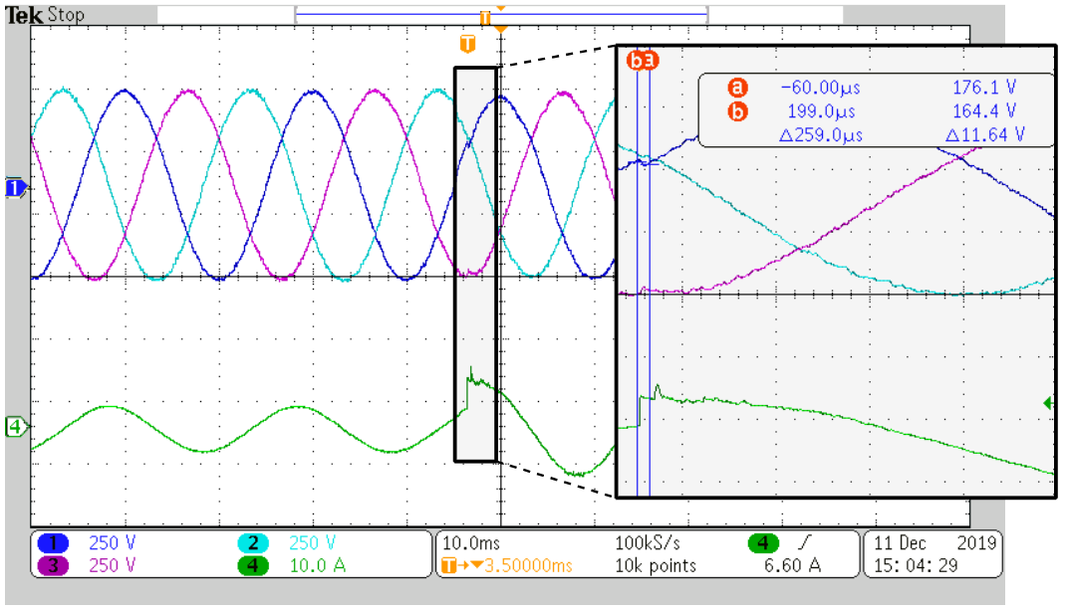
RESULTS
Imitator transient response
Notes:
Fast and accurate load transient response.
Current spike because of switching device.

Slide 27
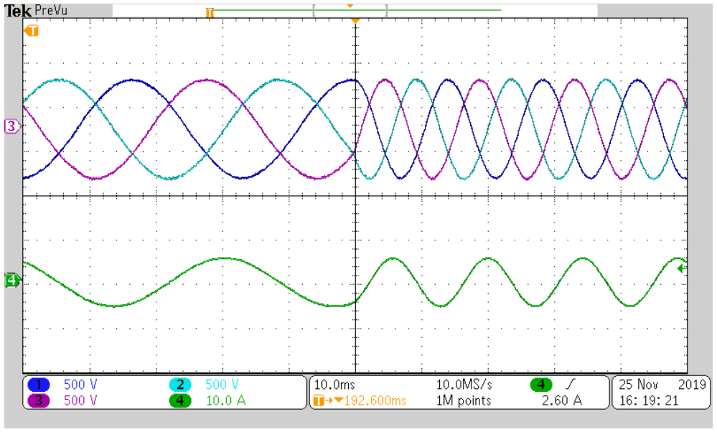
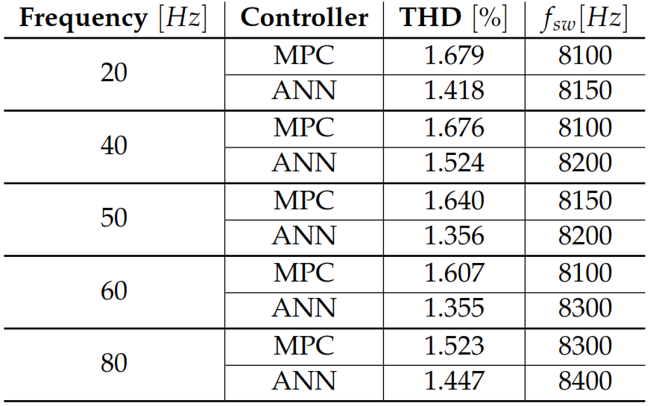
RESULTS
Imitator robustness
Notes:
Ability to extrapolate to untrained data.
Surprisingly, the imitators are robust to changes in reference voltage amplitude and frequency, even though they were not trained for it.

Slide 28
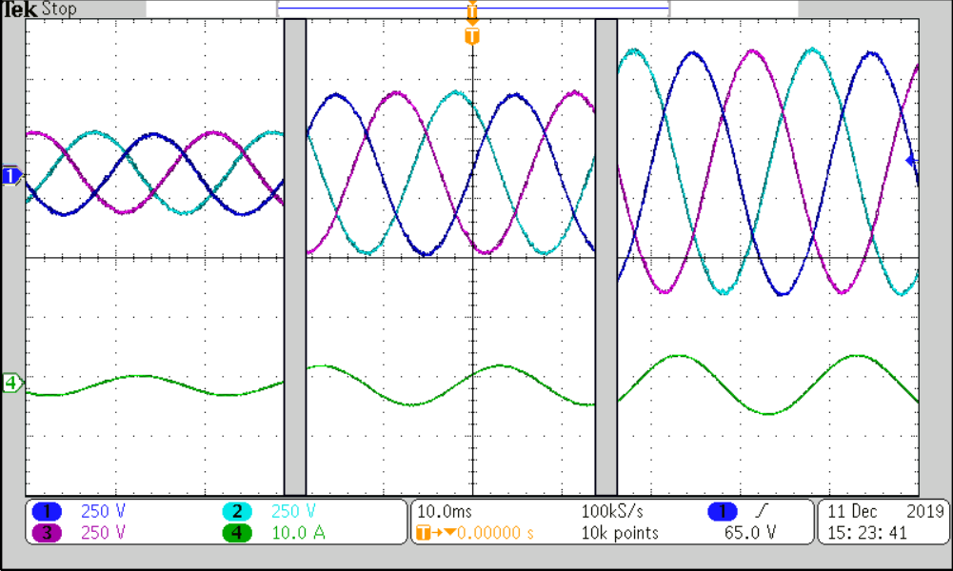
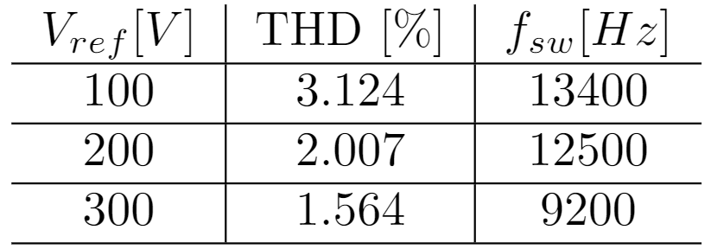
RESULTS
Imitator robustness

Slide 29
CONCLUSION
Computational time vs performance.
ANNs show great potential for application in the field of power electronics.
In principle, the method could be used for any control scheme.
Notes:
Surprisingly, the imitators are robust to changes in reference voltage amplitude and frequency, even though they were not trained for it.

Slide 30
FUTURE WORK
Change the load to resemble a grid.
Improve training for 2 and 3 steps ahead.
Train for more steps ahead.
Implement ANN control in more complex converters.

Slide 31

THANK YOU
Neural network-based imitation of model predictive control for power converters
THANK YOU

